Slide 1



MARKETING IN A
VUCA ENVIRONMENT
by Agu, Emmanuel Chukwuemeka
Group Marketing Director Jotna Nigeria Limited
( The LaCasera Drinks Company)

Slide 2



What do we mean by VUCA?
Why is it Important?
How to conduct Marketing in a VUCA Environment…..
Encourage the Right Values
Be Flexible & Collaborative.
Expand Your Business Models
Create Meaningful Disruption
Predict Consumer Demand
Delist Non Performing Brands
Shape Emerging Habits with Focused Innovation
Sustain New Habits, Using Contextual Cues
Align Messages to Consumer Mindsets
Analyze Consumer Beliefs & Behaviors at Granular Level
Spend Smarter & Avoid Budget Undercutting

Slide 3

THE TERM VUCA
The term VUCA, stands for “Volatility, Uncertainty, Complexity and Ambiguity’’ and originated in the US Army War College in the late 1990s.
It quickly spread to the business world as there are striking similarities in terms of rapid change and uncertainty.
https://www.mindtools.com/pages/article/managing-vuca-world.htm

Slide 4


WHY IS IT IMPORTANT?
An understanding of VUCA is important because it is becoming more and more prevalent in the business world.
One need to be aware of the changes that this kind of environment can cause. A VUCA environment can cause the following changes….
Destabilize people and make them anxious.
Increase the chances of people making bad decisions
Paralyse decision making processes
Jeopardise Long term projects, developments and innovations
Overwhelm individuals and organizations.
Take huge amounts of time and efforts to fight etc
https://www.mindtools.com/pages/article/managing-vuca-world.htm

Slide 5



HOW TO CONDUCT MARKETING IN A VUCA ENVIRONMENT…

Slide 6

ENCOURAGE THE
RIGHT VALUES
Foster the values of ‘’what if’’ and ‘’why not’’ in your Marketing department. A culture where people are free to air their views
Hire agile and creative thinkers (You must get the recruitment right in the first place)
Create ways for teams to contribute fresh ideas. Reward and act on those ideas.
Promote a culture that rewards and correct behaviours and also rewards agility.
Build and be the culture you want your team to reflect!
‘’God is not with the battalion but with the finest shot’’
https://exchange.cim.co.uk/editorial/developing-agile-marketing-in-a-vuca-environment/

Slide 7
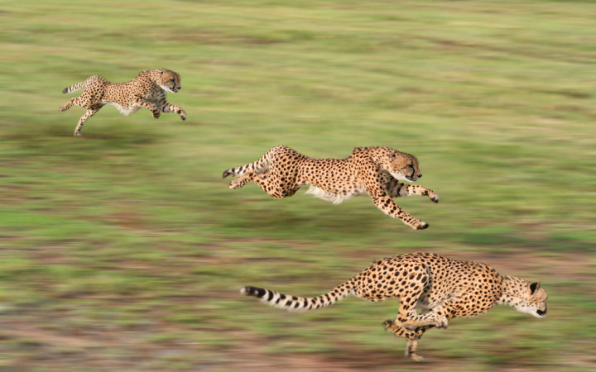
BE FLEXIBLE AND COLLABORATIVE
Thriving in a world of uncertainty and complexity means being adaptive and with a clear sense of vision to discern between a true paradigm shift and market noise
Build fluid & collaborative structures to respond to the forces of change
Remove internal barriers and build internal bridges
Break down every silos and destroy internally imposed bureaucracies
Enforce Marketing and Sales team collaboration & alignment on new ways of working suited to agility on key strategic initiatives

Slide 8

EXPAND YOUR BUSINESS MODELS
Brand Z’s research shows that brands with five or more areas of business are on an average 4x bigger and growing 10x faster than others.
Marketing in a VUCA environment may require the pursuit of multiple business models.
SUBC (Seven Up Bottling Company) recently moved into the production of sanitizer (2Sure Sanitizer) as Covid-19 pandemic continued unabated in Nigeria.
DSTV evolved their business model from Subscription to on-demand (ShowMax) and local content development (Africa Magic Original Movies)
Indomie Café; from Supermarket shelf to on-premise environment.
Uber moving into home food delivery with UBER EATS & Scuber for under water ride hailing etc.
The Dangote & Gokada play books also comes to mind

Slide 9

CREATE MEANINGFUL DISRUPTION
Disruption has been proved overtime to drive brand value growth
Meaningful disruption is key to scalable relevance.
What do disruptors have in common? They offer original product and services which meet evolving consumer needs and expectations.
Brands must strive to be in a position where it is more relevant than well-known as that space portends an opportunity versus been in a position where it is well-known but not been relevant
Like Martin Guerrieria said and I quote ‘’ The power of the consumer will always be more powerful than the power of the brand’’

Slide 10
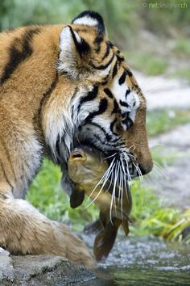
PREDICT CONSUMER BEHAVIOUR
Brands must evolve along consumer choice, taste and medium of communication.
Understanding the consumer in the midst of information explosion, plethora of media & channels coupled with intense competition must be based on data and analytics .
Data and analytics have become more critical than ever to accurately forecast demand across product segments.
Consumer responses to VUCA environment have made demand more difficult to gauge accurately. The past is no longer a predictor of future demand.
Through the use of analytics, marketers should develop a robust comprehension of cyclical patterns and its impact on consumer behavior. And with this accurately predict behaviors.
“Foresight beats hindsight in a changing world’’

Slide 11
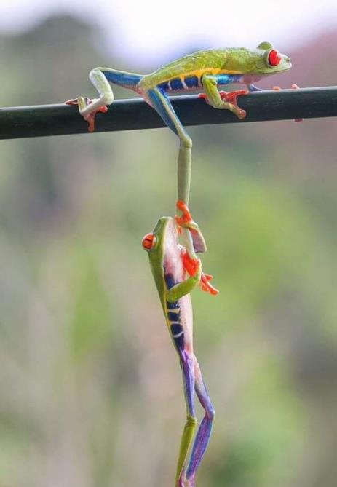
DELIST NON PERFORMING BRANDS
Brands with low prospect for growth and profitability will generate negative returns and as such are less likely to achieve their original aim. The cost of delisting far outweighs any future benefit
Investment efforts that will drive the top level growth will require the weeding out of those brands that doesn’t work from the portfolio to allow focus on fewer, bigger and stronger brands.
Consolidate and concentrate your marketing efforts on your winning brands and become category kings with those brands. This is a typical war principle. ‘’ fight and take over a territory, consolidate your win, then move to another territory to conquer’.

Slide 12

SHAPE EMERGING HABITS WITH FOCUSED INNOVATION
Be bold with new Innovation approaches.
Identify expansive new demand led opportunities.
Target these opportunities with bigger and more scalable innovation product(s)
In a VUCA environment, innovation decision must be “choiceful” and must be executed with scale and speed
Covid -19 has thrown up a white space opportunity in innovation around affordability, health, safety & hygiene through the use of contactless solutions with strong functional benefits
Unilever reported a sales spike in beverages that contain zinc and vitamin C, such as Lipton Immune Support tea. It is also aligning its innovation priorities with consumers’ emerging health-and-wellness concerns

Slide 13

SUSTAIN NEW HABITS, USING CONTEXTUAL CUES
Habits can be formed when a consumer begins to associate a certain behaviour with a particular context; eventually that behaviour can become automatic.
Marketers can help turn behaviors into habits by identifying the contextual cues that drive those behaviors.
A contextual cue can be a particular task, time of day or object of placement e.g. more consumers are keeping hand sanitizer and disinfecting wipes near entryways, toilets , office tables etc for easy access and as a reminder to keep hands and surfaces clean
Product packaging and marketing that reinforces the put-it-by-the-doors/toilets/tables behaviour can help consumers sustain the habit.

Slide 14

ALIGN MESSAGES TO CONSUMER MINDSETS
The heightened emotions and increased polarization created by VUCA environment could drive lasting changes in consumer’s behaviour and shape their long –term preferences.
Marketers should ensure that all their brand communications are attuned to consumer sentiment.
The quality of the communication and its ability to strike the right tone and chord will increasingly become a competitive advantage when things returns to normal
Consumers will see through and reject messages and actions that are theatrical and seek to commercialize social issues. A brand’s communication must align with the mood of the moment; otherwise, the message will not ring true
Consumers are taking notes of brands that demonstrate care and concern for people during crisis periods. This may have a long term implications on how consumers connect with brands

Slide 15

ANALYZE CONSUMER BELIEFS AND BEHAVIOURS
Consumer beliefs, habits, occasions, and emotional need states will continue to evolve during crisis period.
For marketers to stay abreast of these changes, they must always conduct primary insights- work, with focus on identifying changed behaviors, associated changed beliefs and motivators to get a comprehensive picture of the changing consumer decision journey.
Marketers must keep a closer eyes on the evolution of consumer behaviour at a granular level, week on week or bi-monthly basis. Gone are the days of quarterly brand tracking
Marketers must, as a necessity bring consumer data and creativity together
Data and analytics must be at the heart of decision making. Creative solutions inspired by human truth must be developed from it

Slide 16

SPEND SMARTER AND AVOID BUDGET UNDERCUTTING
Investing to create and sustain a competitive advantage is still the best recipe for dealing with VUCA environment.
Of Course, spending on marketing tactics that do not work is never wise and should not be encouraged.
Marketers should consider prioritizing and scaling up new digital capabilities to enable digital touch points with consumers.
Marketers must, as a necessity leverage on the abundance of fallow inventories that abounds during crisis period and negotiate hard nose discounts for their brands. Cash is king
Marketing/marketers should not go on isolation during crisis period because of budget cut. Be creative with what you have and let the voice of your brand(s) be heard..
Marketing still remains the holy grail that holds strategy and sales together and has the potential to rescue any business from crisis.

Slide 17
ANY QUESTIONS?

Slide 18


