Slide 1

Thoughts on Marketing in VUCA
Chris WULFF-CAESAR
ADVAN CMCO Forum
6th August 2020

Slide 2

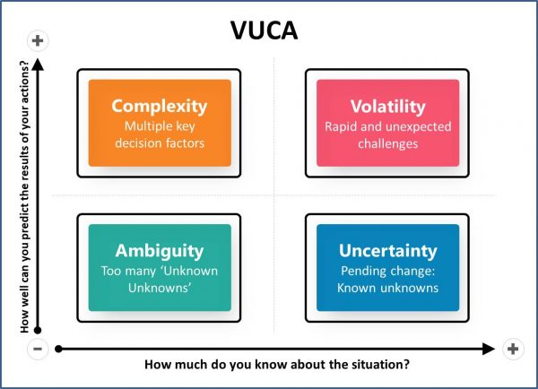




Lockdown
Easing Lockdown

Slide 3
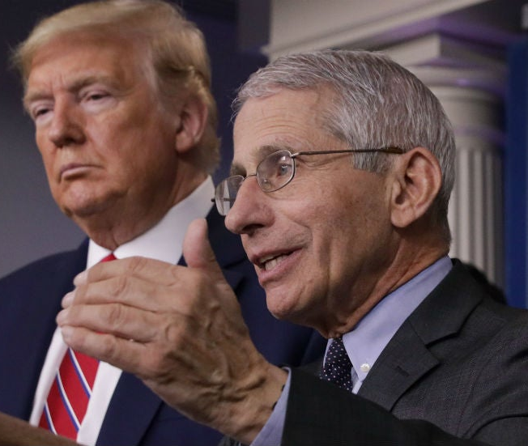
The quote below epitomizes all we know about operating in a VUCA environment
“…you don’t make the timeline, the virus makes the timeline”
Dr Anthony Stephen Fauci
Director National institute of allergy and infectious diseases (USA)

Slide 4

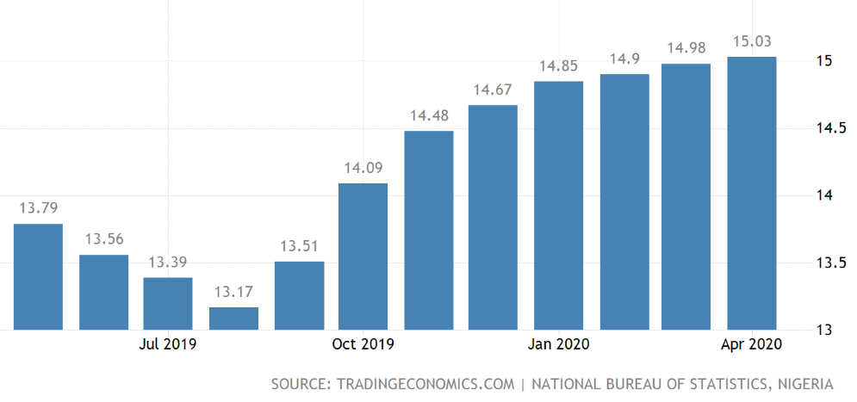
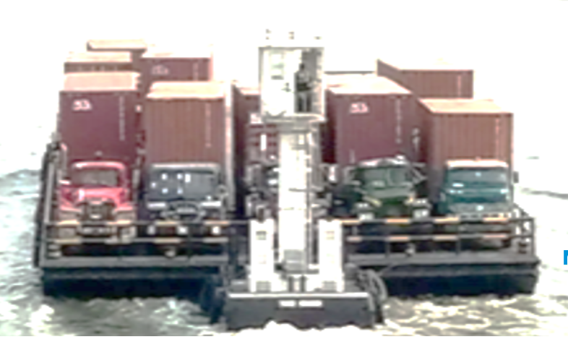



Nigerian businesses (and our consumers) are at the epicenter of this VUCA environment
Nigeria - Facing reality (its more than just the pandemic)
(some thoughts from my experiences)
Country’s Revenue impacted by declining oil prices
COVID-19
Rising FX rates and availability
Food inflation is higher than core inflation.
Port congestion
Lockdown & Curfews
Social Distancing
Supply Chain disruptions impacting raw & packaging materials sourcing & logistics
Oil price at $44 below Budget’20 Benchmark of $57.
CBN Rate up to N360/$. I&E at N388/$.
Parallel market as high as N460/$.
2014 rate was N150/$
Up to 15.03% in April’20
Upward trend since Q3 of 2019
Turnaround time per truck from port to warehouse (25km)
Increases from 21 days to 45days

Slide 5


Marketing must be a lighthouse to steer business through the storm

Slide 6










Champion our primary mandate as there is no business without consumers
“…like lighthouses, our activities as marketers needs to shine the right light to guide ALL our consumers to the safe port of our businesses during VUCA times”
5%
TOP
30% MOP
… “whoever is paying for your good or service to use is your consumer. “
Doyin Salami
65%
BOP
=/<$2

Slide 7
Apart from our primary responsibilities, we need to actively use these 6Es to steer consumers to our businesses during extreme times
1
Empathize
Entertain
4
2
Educate
Everyone
5
3
Encourage
6
Evolve

Slide 8

Some practical things to focus on in the short term
Set Communication Guidelines
Responsibly sustain sales in the short term
Think Long Term
Engage all audiences and stakeholders
Activate and live your purpose
Listen
Be you
Be transparent
Keep it simple
Be agile and flexible
Reallocate spend
RTM evolution/ E-commerce
Rise above self serving and transactional interests
Sustain broad reach
Empathy
Beware appearing opportunistic
Transparent leadership
Stakeholder mapping beyond consumers and customers
Identify opportunities for shared value programs
Do more, say less
Activate your brand purpose
Not every brand needs to turn a care giver
Source: WPP

Slide 9
Be commercially agile and operationally shrewd
Ensure the “science” of marketing” practice leads
Your strategy is in your product/service
Wield your pricing sword with circumspection
A&P investment is great to have but not a God given right
Everyone has to become a front line person; that’s where real ideas and innovation bubble to the surface
The right people, agencies and partners always make a difference
Let data create transparency and guide you to the “fish”
Benchmark all the time
Speed up decision making
Learn and re-emphasize basics

Slide 10

Overall, marketers must be guided by business purpose,
Always think Long Term
Rekindle the Basics in our vocation
Eliminate Waste with surgical precision
Feed your growth through cost efficiency
In spite of the environment, have an expansive Growth Mindset
Build a holistic appreciation of your business offering

Slide 11
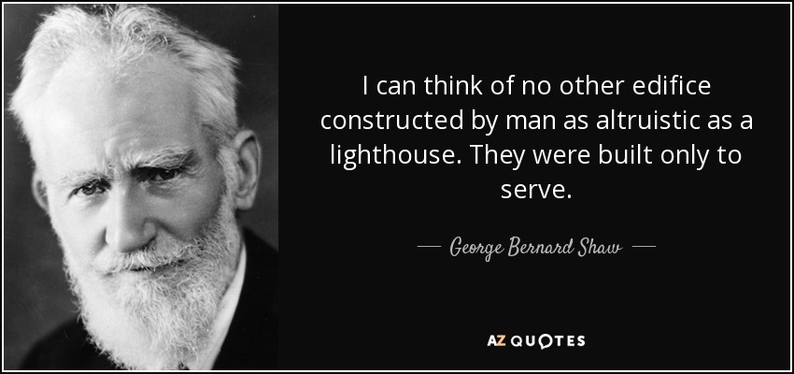

Slide 12


ADVAN must remain a dependable “Lighthouse” for all of Nigeria
The key “Tenets” of ADVAN
Visionary Thought Leadership –in influencing necessary change in the nation’s marketing space.
Knowledge Sharing and Capacity building
Stakeholder Engagement to influence Industry policies.
Data, Research and Insight in advocating for the needed information which aids effective planning

Slide 13
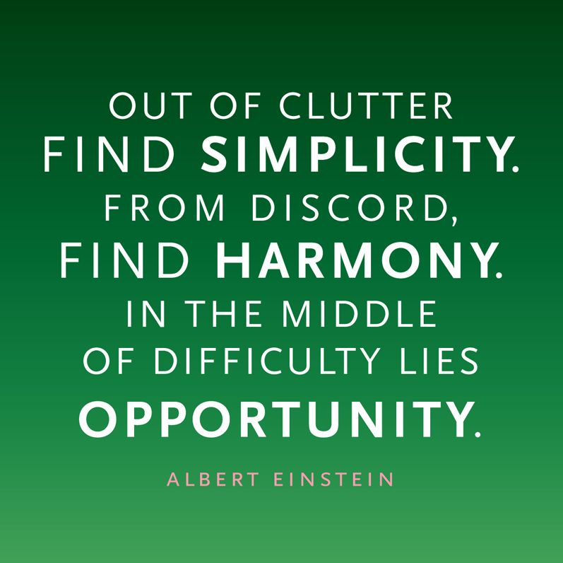
There will be Winners and Losers
…unless you act fast, remain agile and flexible

Slide 14
Summary
The whole world
is in VUCA (not just Nigeria). We have to navigate our own issues
Be guided by your
business purpose
Face the reality,
not back away
Commercially agile and operationally shrewd
Champion the consumer. Use the 6Es to steer during VUCA
ADVAN must shine like a lighthouse for all Nigeria
Marketers must guide consumers to the
port of business
Opportunities abound even
in VUCA environments

Slide 15

Thank You

